Slide 1
Semantic Analysis

Slide 2
Attribute Grammars
Idea: associate attributes with each node in the (abstract) syntax tree
Examples of attributes
  Type information
  Storage location
  Assignable (e.g., expression vs variable; lvalue vs rvalue for C/C++ programmers)
  Value (for constant expressions)
  etc. …
Notation: X.a if a is an attribute of node X

Slide 3
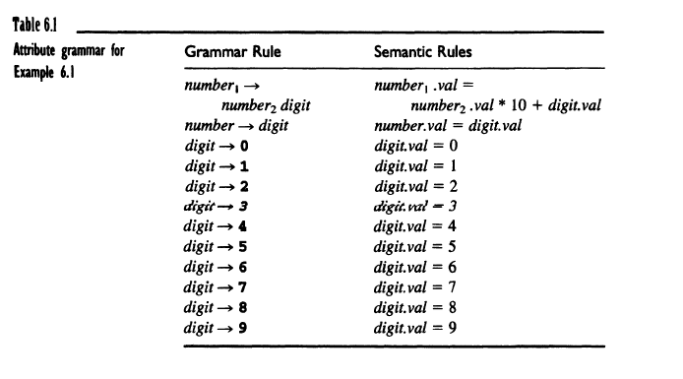

Slide 4
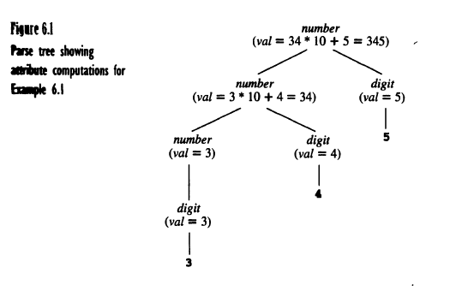

Slide 5
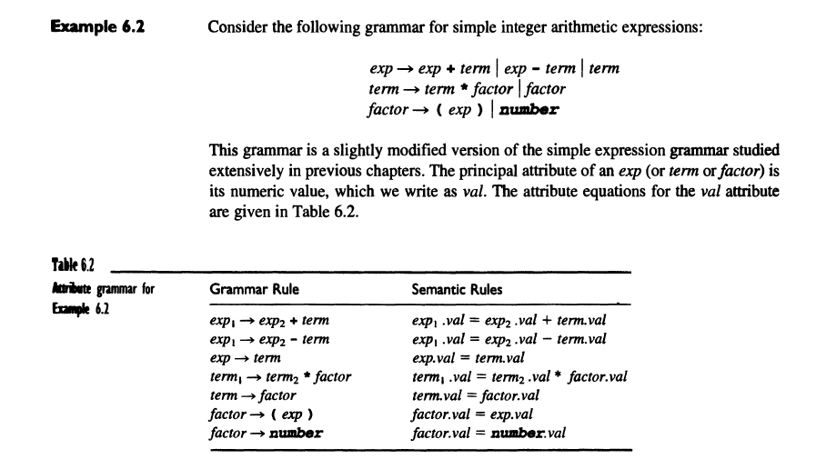

Slide 6
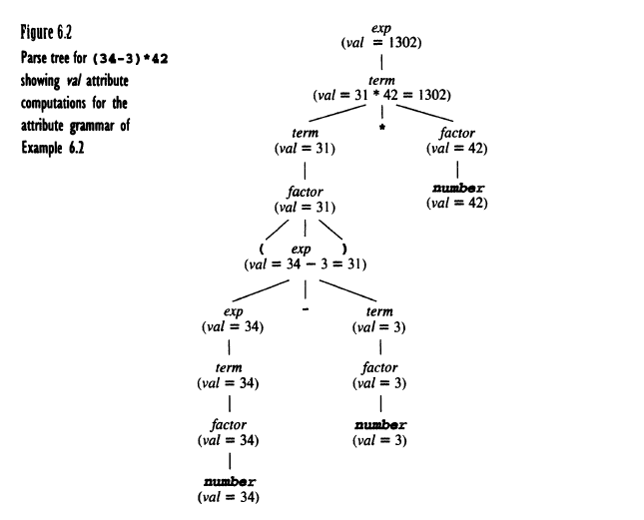

Slide 7
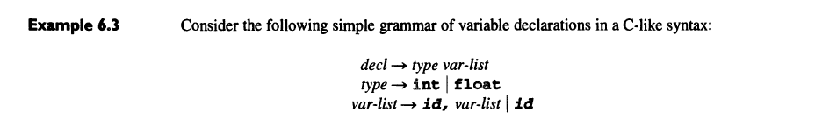

Slide 8
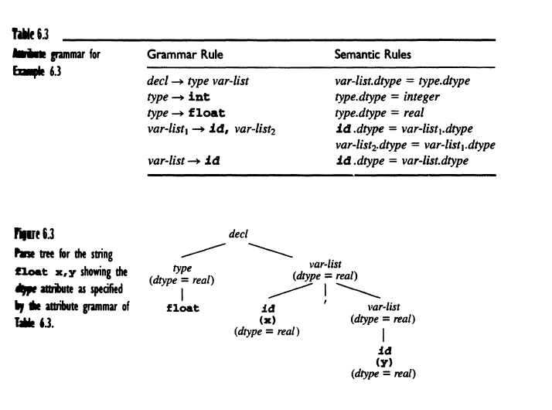

Slide 9
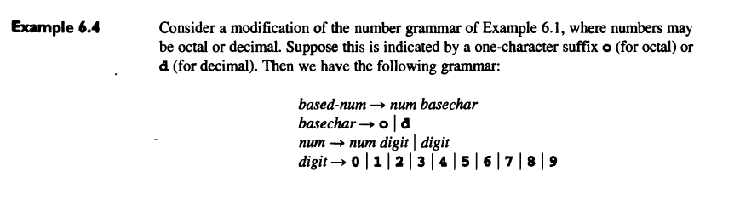

Slide 10
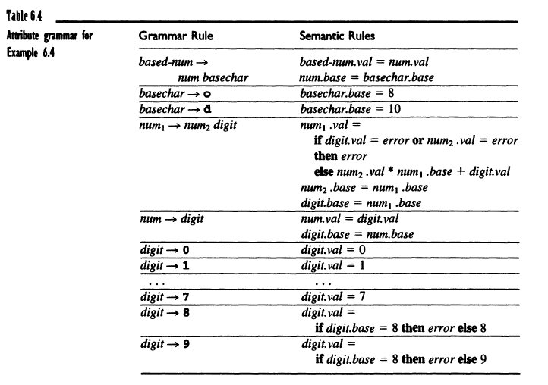

Slide 11
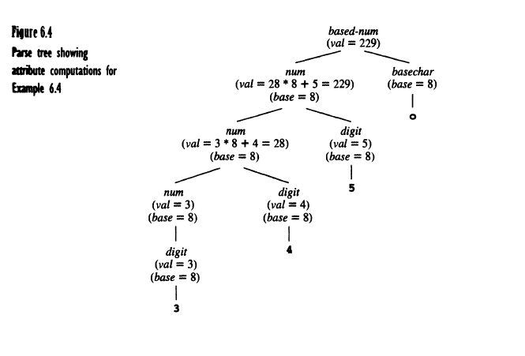

Slide 12
Dependency Graph

Slide 13
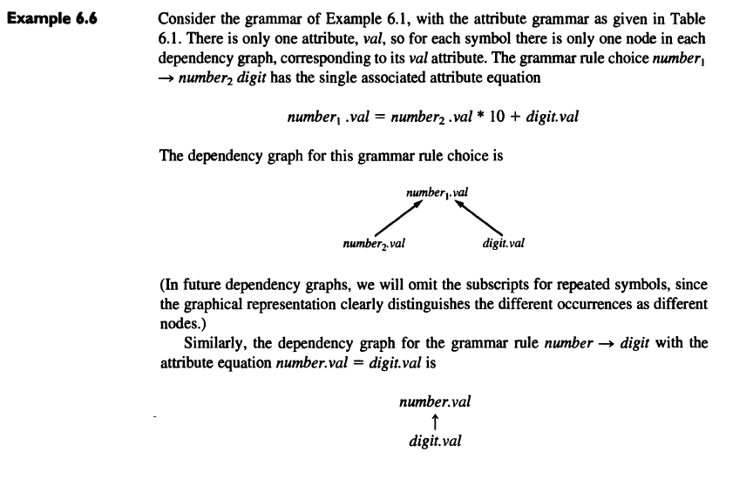

Slide 15
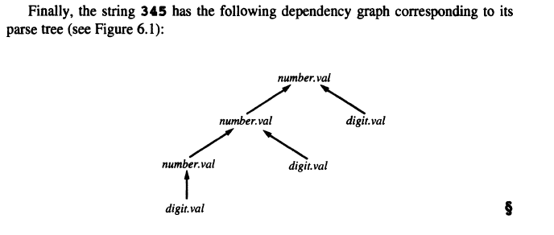

Slide 17
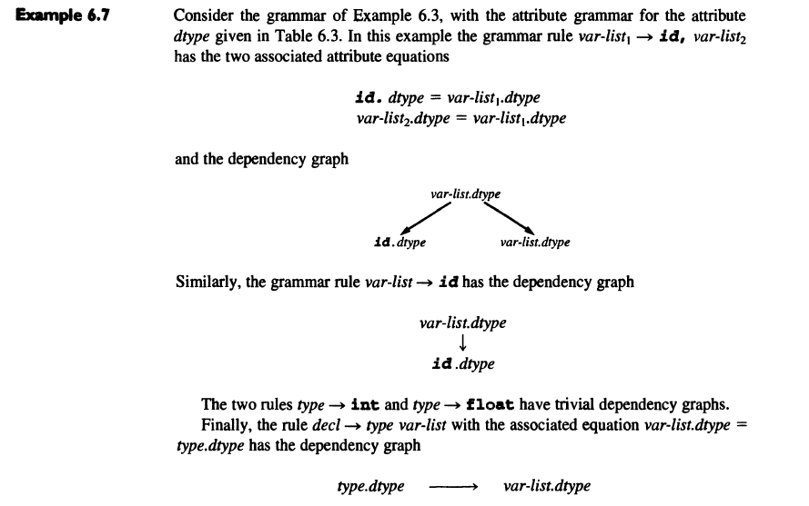

Slide 18
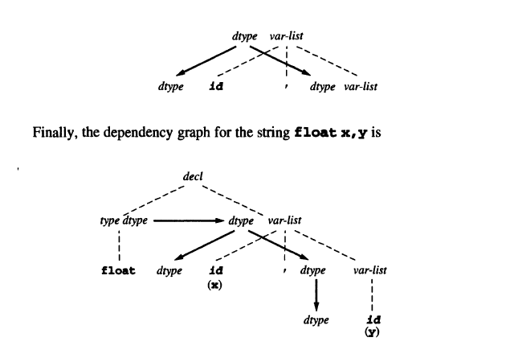

Slide 19
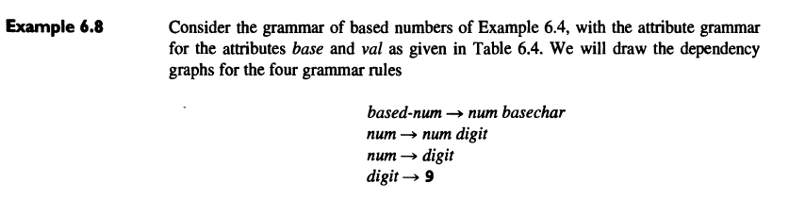

Slide 21
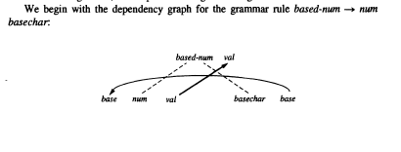

Slide 22
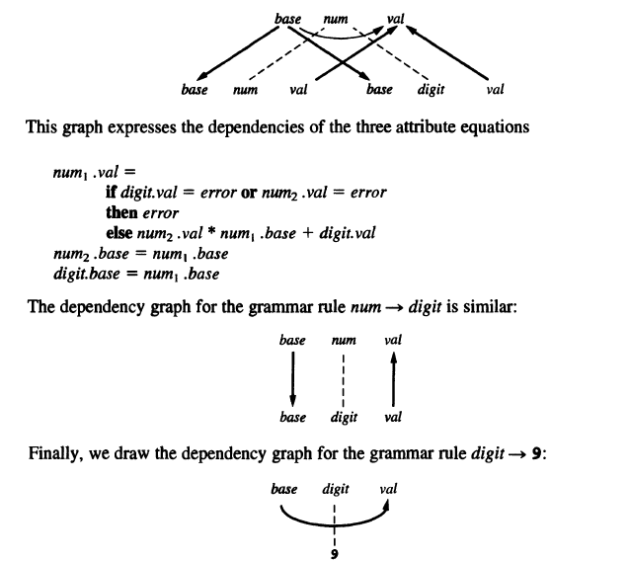

Slide 23
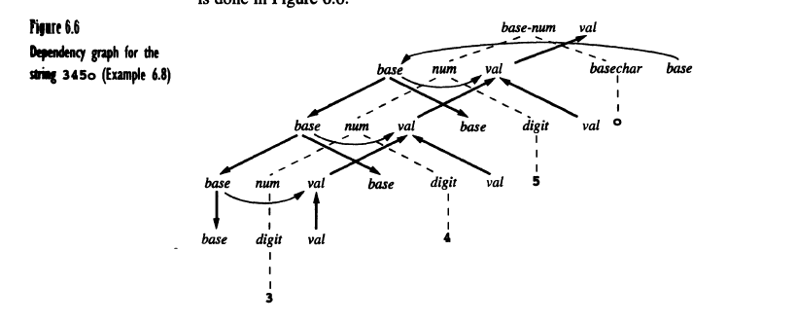

Slide 24
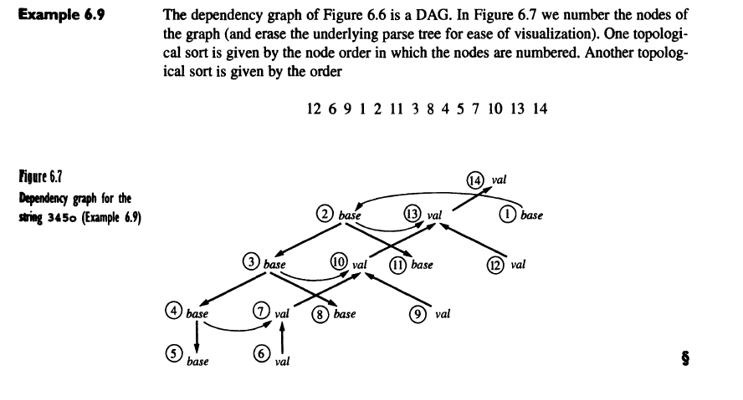

Slide 25
Synthesized Attribute

Slide 26


Slide 27
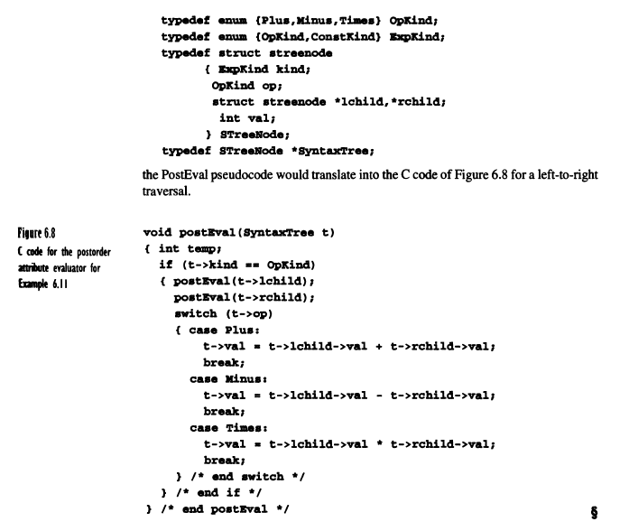

Slide 28

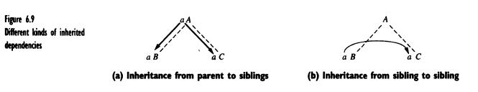
Inherited Attribute

Slide 29
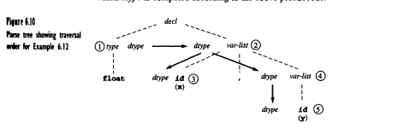

Slide 30
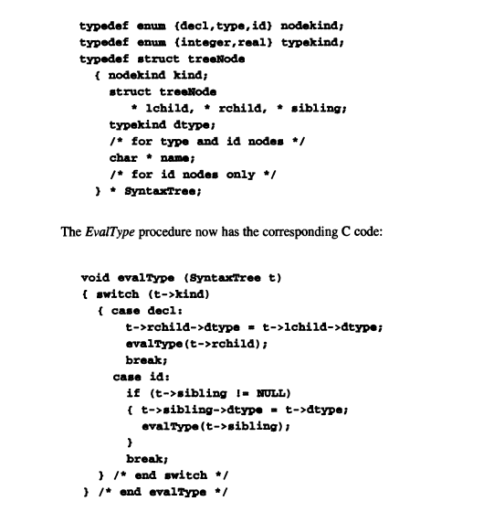

Slide 31
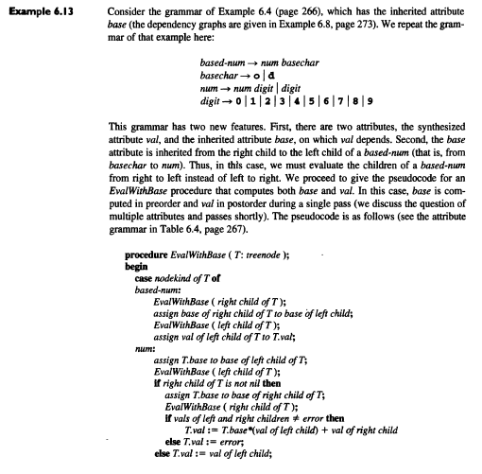

Slide 32
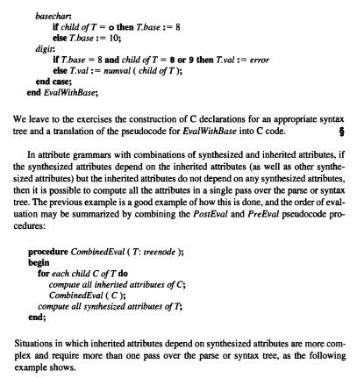

Slide 33
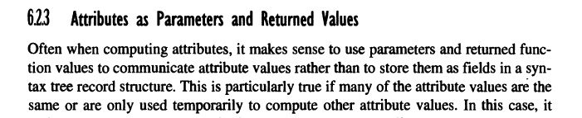

Attributes as parameters and return values

Slide 34
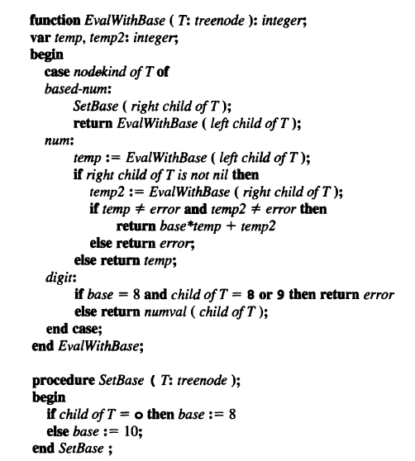

Slide 35
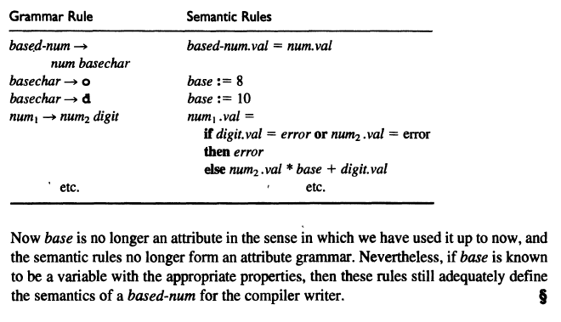

Slide 36
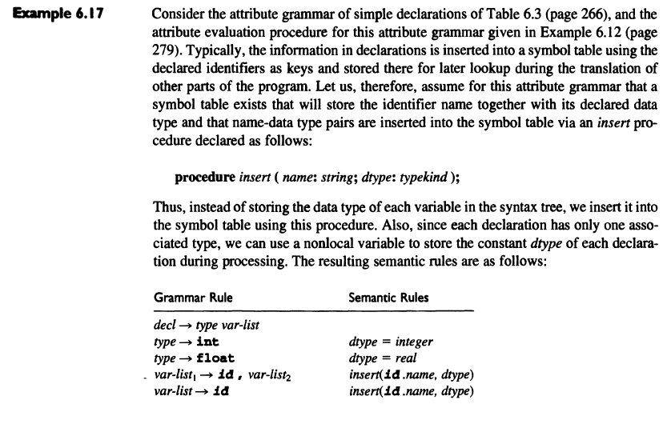

Slide 37
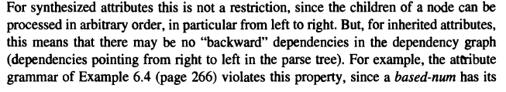
Computation of Attribute During Parsing

Slide 38
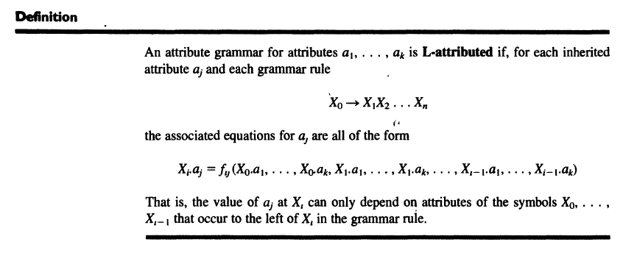
L-Atrribute

Slide 39
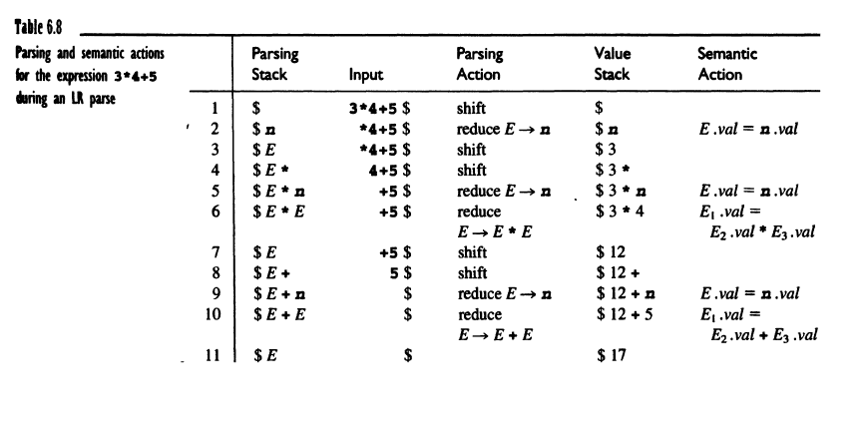

Slide 40
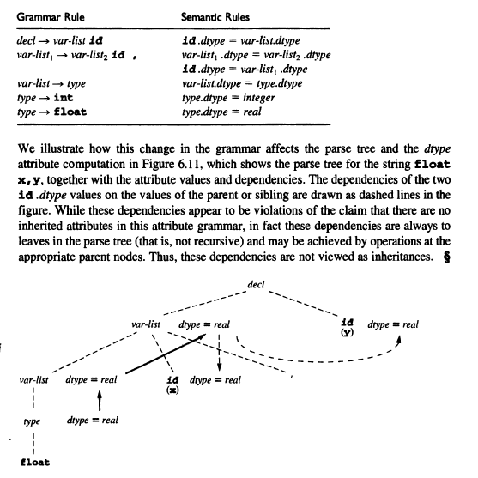
Dependence of Attribute Computation on the Syntax

Slide 41
Type Expressions and Type Constructors
Type expressions denote the type of language constructs (variables, functions, etc.).
Basic Types (Primitive):
Atomic types provided by the language:
  integer, real, boolean, char, void
Examples:
  integer: Represents whole numbers (e.g., 42).

Slide 42
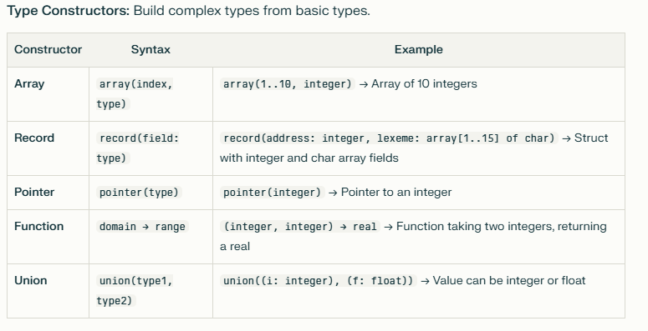
Type constructors

Slide 43
Type Names and Type Declarations
User-defined aliases for existing types, created using typedef.
Why Use Them?
  Increase code readability
  Simplify complex type usage
  Make code easier to maintain
Examples:
typedef unsigned long ulong;
typedef int Coordinate;
Usage: ulong fileSize; Coordinate x, y;
Benefit: Now, ulong and Coordinate can be used just like built-in types, making declarations clearer and less error-prone.

Slide 44
Struct Type Names and Declarations
Struct Type Name:
Used to define complex data structures with a single name.
Example:
typedef struct { char name[20]; int id; float gpa; } Student;
Usage:
Student s1, s2; s1.id = 1001;

Slide 45
Recursive Type
A type defined in terms of itself, commonly used for linked lists and trees.
C Example (Linked List Node):
typedef struct Node
{ int data;
struct Node *next; }
Node;

Slide 46
Type Equivalence
Type Equivalence:
Determines when two types are considered the same by the compiler.
Two principal forms:
  Name Equivalence: Types are equivalent if they have the same name or were declared in the same declaration.
  Structural Equivalence: Types are equivalent if their structures are built using the same type constructors from the same basic types.

Slide 47
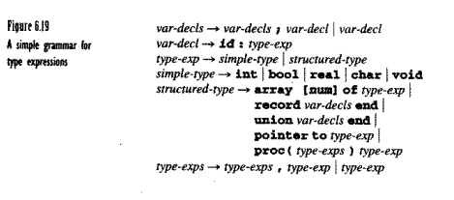

Slide 48
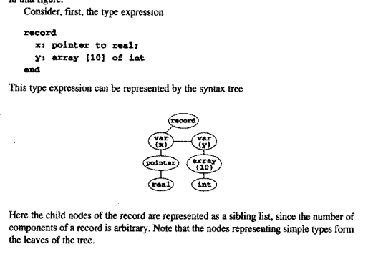

Slide 49
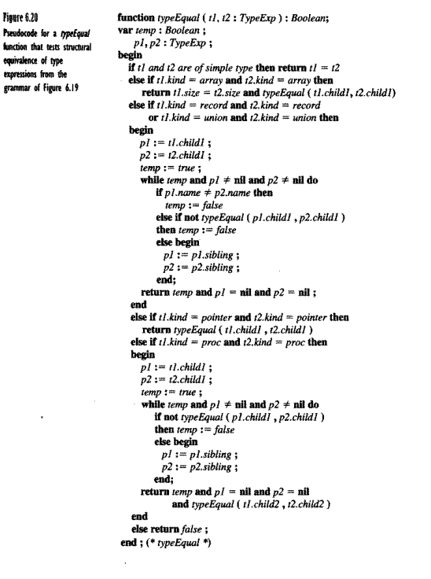

Slide 50
Recursive Types and Type Equivalence
Recursive Type Equivalence:
Recursive types can pose challenges for structural equivalence, as the type checker must recognize equivalence even when types refer to themselves.
struct NodeA { int data; struct NodeA* next; };

Slide 51
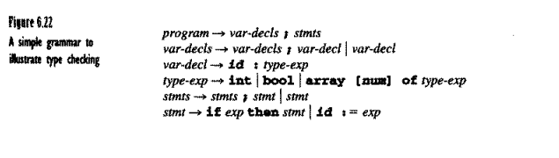
Type inference and Type Checking

Slide 52
